Slide 1
MACHINE LEARNING: GENETIC AND EMERGENT

Slide 2
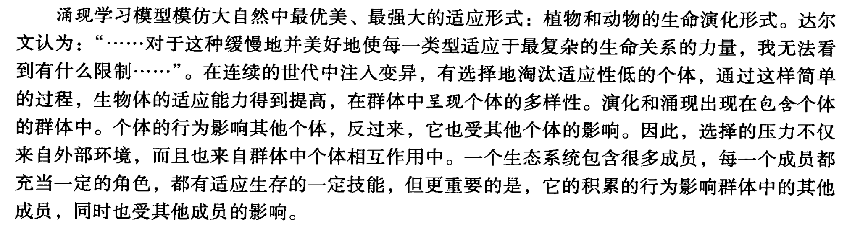
12.0 Social and Emergent Models of Learning
Emergent models of learning simulate nature’s most elegant and powerful form of adaptation: the evolution of plant and animal life forms. An ecosystem has many members, each with roles and skills appropriate to their own survival, but more importantly, whose cumulative behavior shapes and is shaped by the rest of the population.

Slide 3
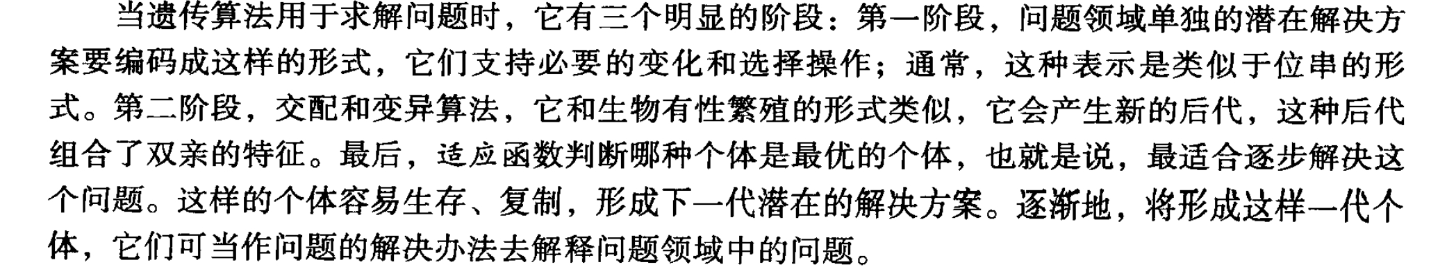
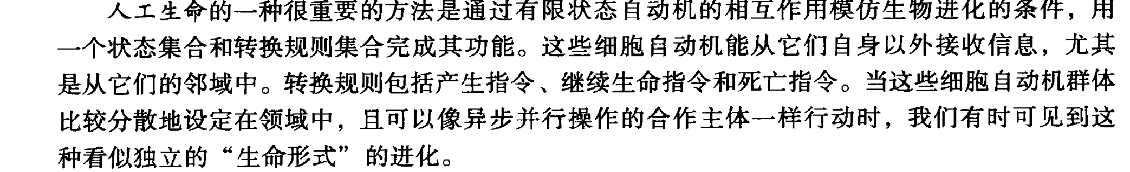
When the genetic algorithm is used for problem solving, it has three distinct stages: first, the individual potential solutions of the problem domain are encoded into representations that support the necessary variation and selection operations. In the second stage, mating and mutation algorithms. Finally, a fitness function judges which individuals are the “best” life forms.
An important approach for artificial life, or a-life, is to simulate the conditions of biological evolution through the interactions of finite state machines, complete with sets of states and transition rules.

Slide 4
In Section 12.1 we introduce evolutionary or biology-based models with genetic algorithms.
In Section 12.2 we present classifier systems and genetic programming.
In Section 12.3 we present artificial life.

Slide 5
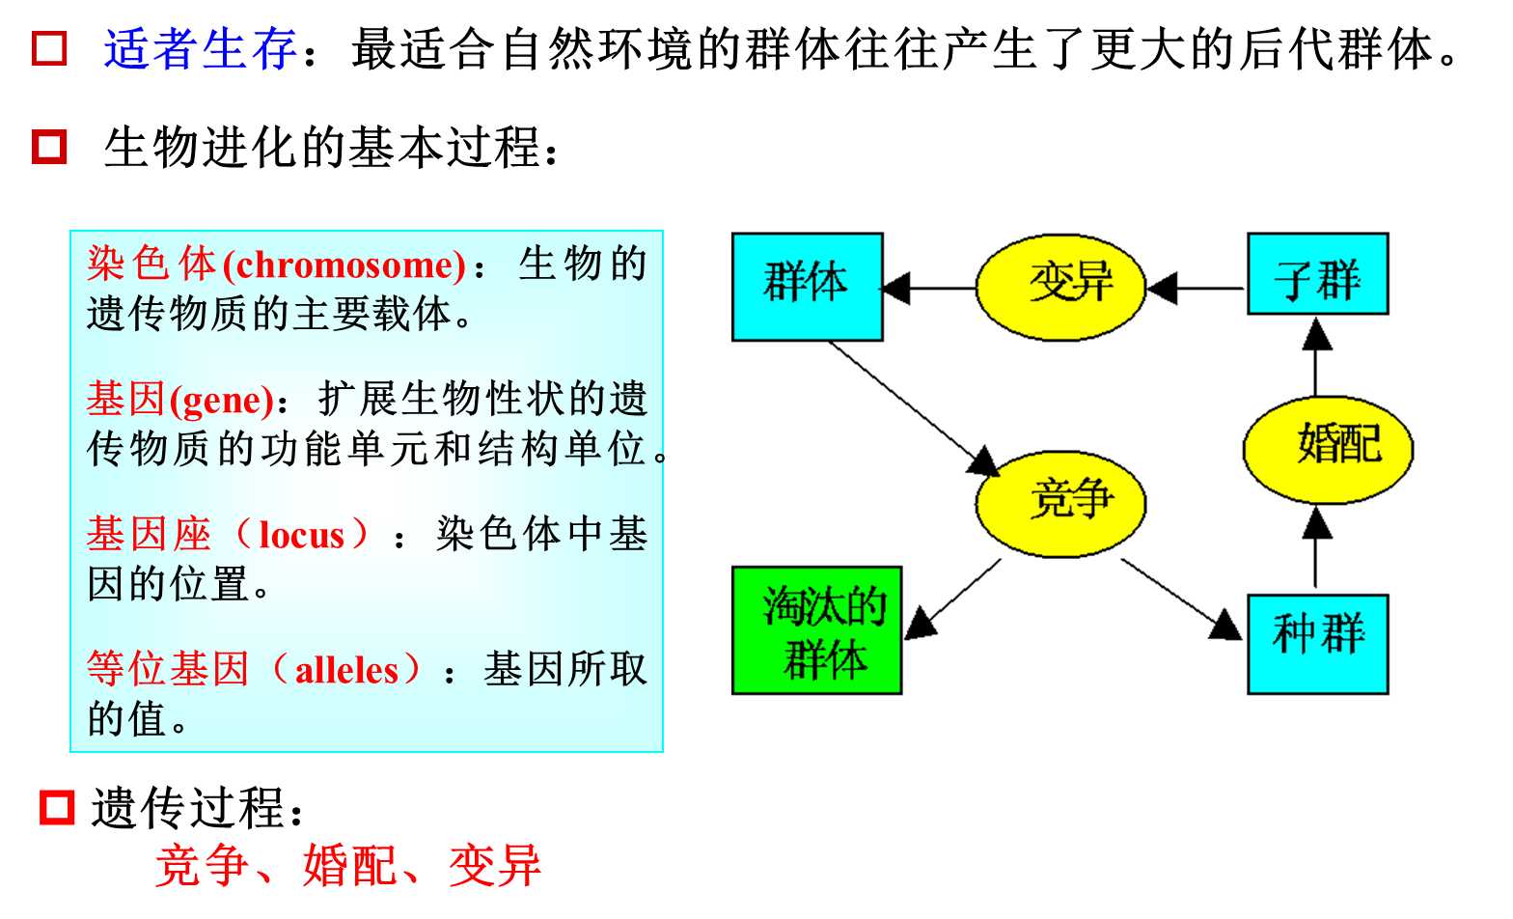
12.1 The Genetic Algorithm

Slide 6
12.1 The Genetic Algorithm
Like neural networks, genetic algorithms are based on a biological metaphor: They view learning as a competition among a population of evolving candidate problem solutions. A “fitness” function evaluates each solution to decide whether it will contribute to the next generation of solutions. Then, through operations analogous to gene transfer in sexual reproduction, the algorithm creates a new population of candidate solutions.
Let P(t) define a population of candidate solutions, ,at time t:

Slide 7
We now present a general form of the genetic algorithm:
procedure genetic algorithm;
begin
set time t:=0;
initialize the population P(t);
while the termination condition is not met do
begin
evaluate fitness of each member of the population P(t);
select members from population P(t) based on fitness;

Slide 8
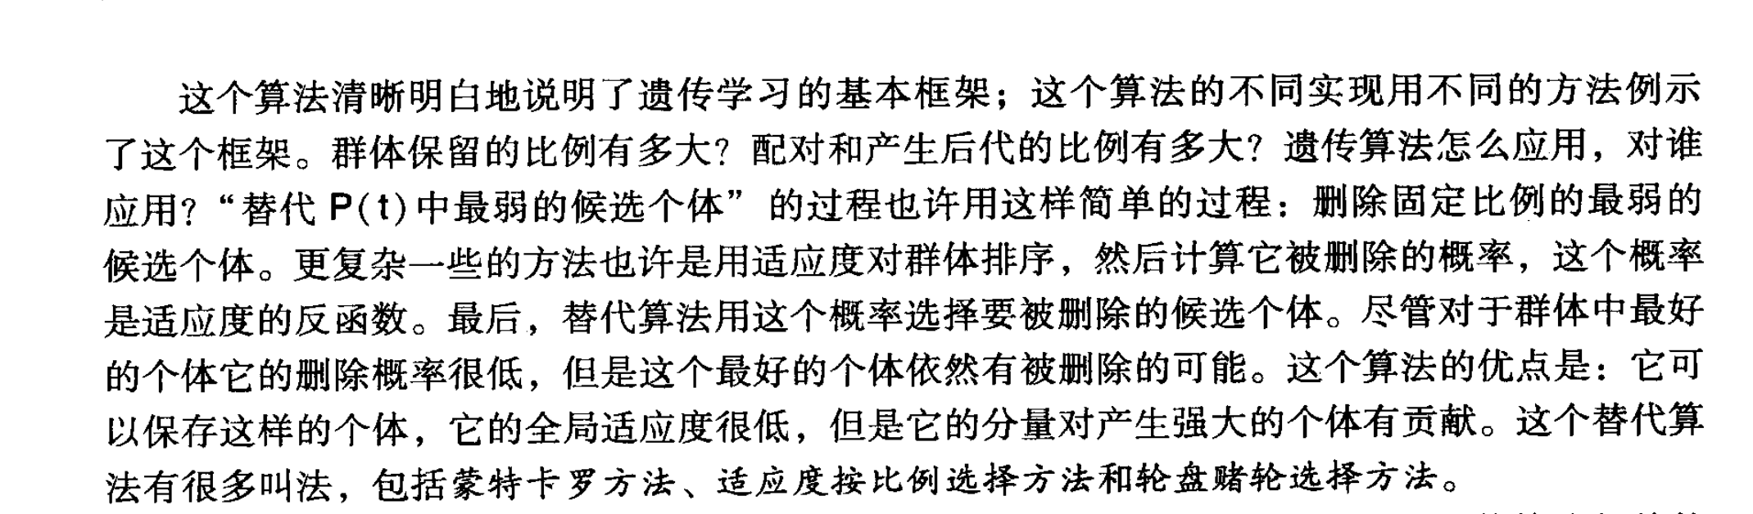
produce the offspring of these pairs using genetic operators;
replace, based on fitness, candidates of P(t), with these offspring;
set time t :=t+1
end
end
Although the probability of elimination would be very low for the fittest members of the society, there is a chance that even the best individuals could be removed. The advantage of this scheme is that it may save some individuals whose overall fitness is poor but that include some component that may contribute to a more powerful solution.

Slide 9
6.2.9 遗传算法的一般步骤

Slide 10
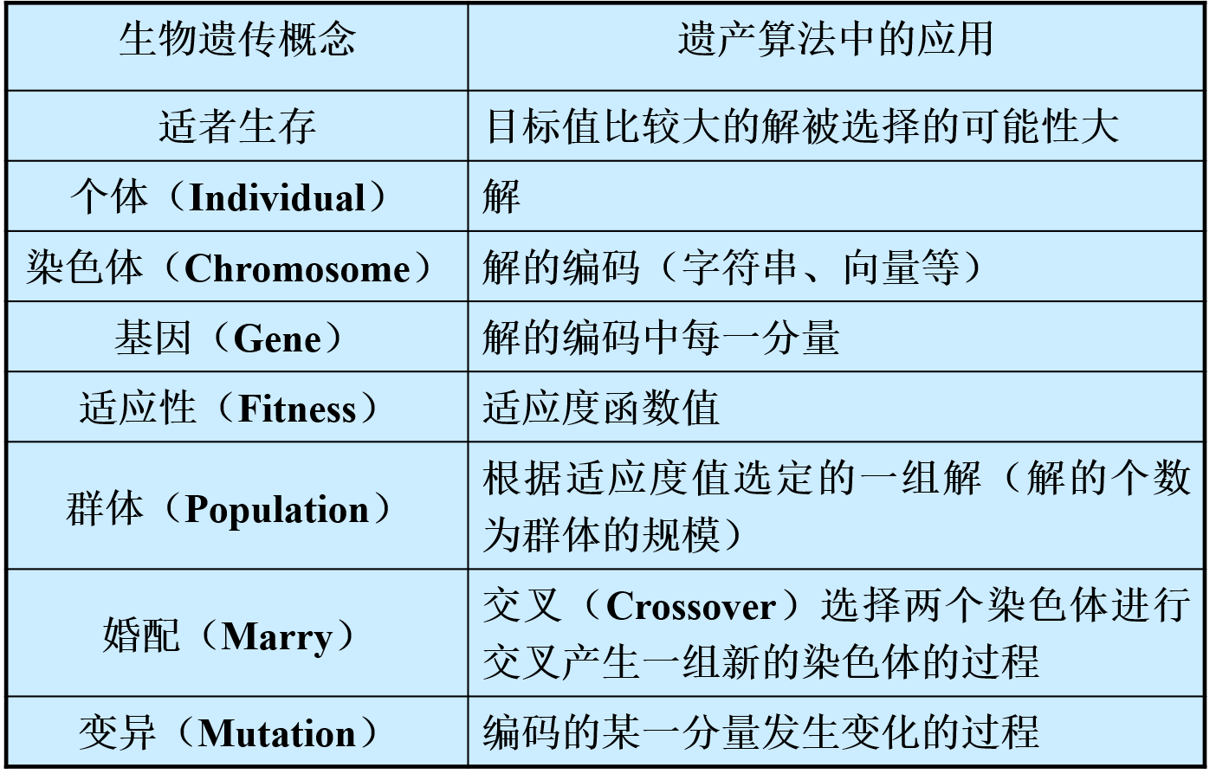
6.2.9 遗传算法的一般步骤

Slide 11
6.2.9 遗传算法的一般步骤
当两个生物机体配对或者复制时，它们的染色体进行混合，产生一对由双方基因组成的新的染色体，这一过程称为交叉或者重组。
遗传算法中起核心作用的是交叉算子，也称为基因重组。采用的交叉方法能够使父串的特征遗传给子串，字串应能够部分或者全部地继承父串的结构特征。

Slide 12
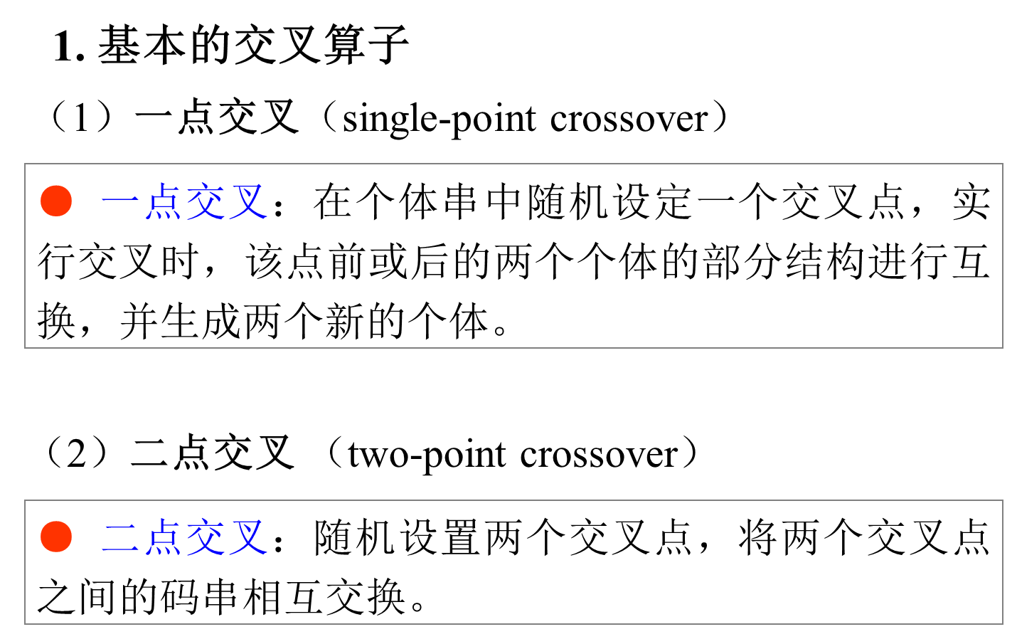
6.2.9 遗传算法的一般步骤

Slide 13
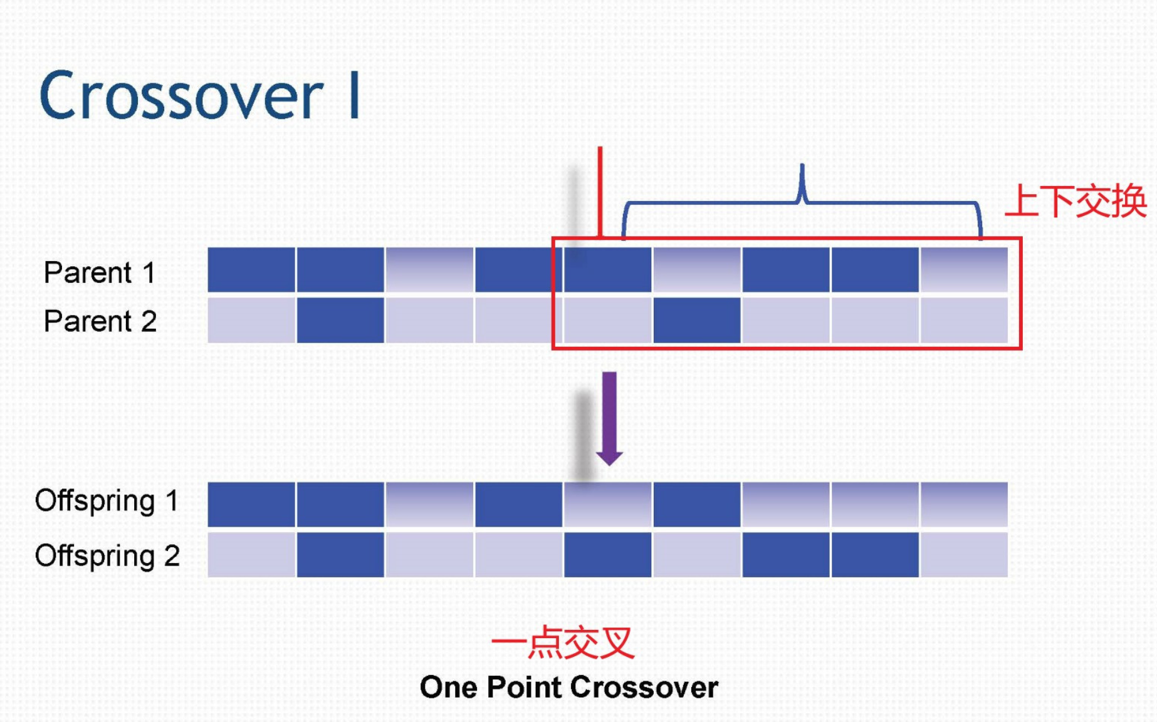
6.2.9 遗传算法的一般步骤

Slide 14
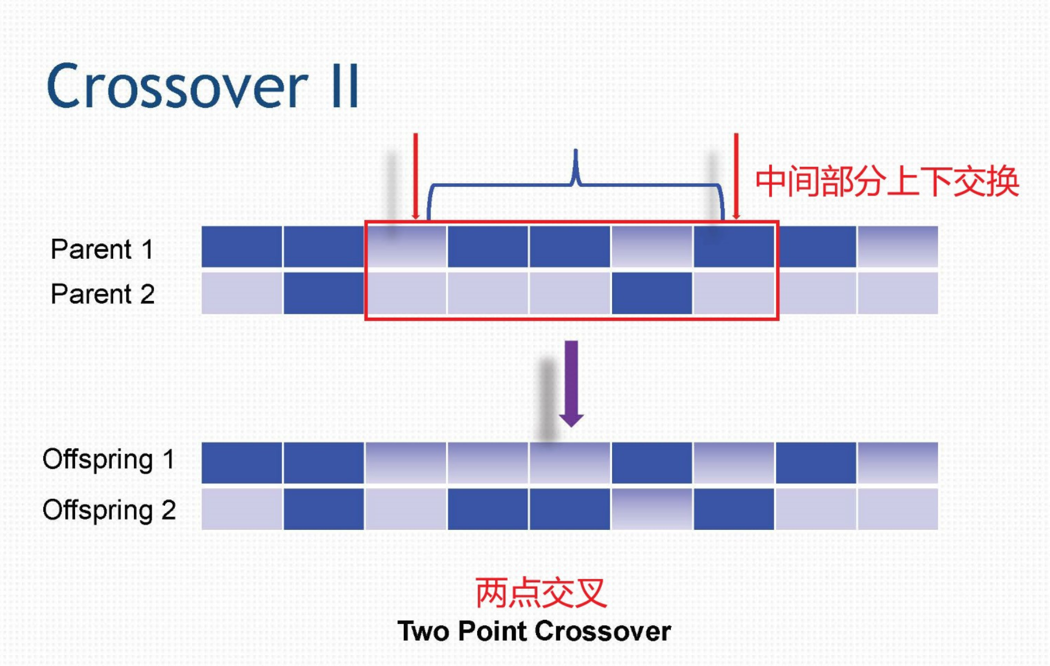
6.2.9 遗传算法的一般步骤

Slide 15
Suppose we want a genetic algorithm to learn to classify strings of 1s and 0s. We can represent a population of bit strings as a pattern of 1s, 0s, and #s, where # is a “don’t care,” that may match with either 0 or 1.Thus, the pattern 1##00##1 represents all strings of eight bits that begin and end with 1 and that have two 0s in the middle.

Slide 16
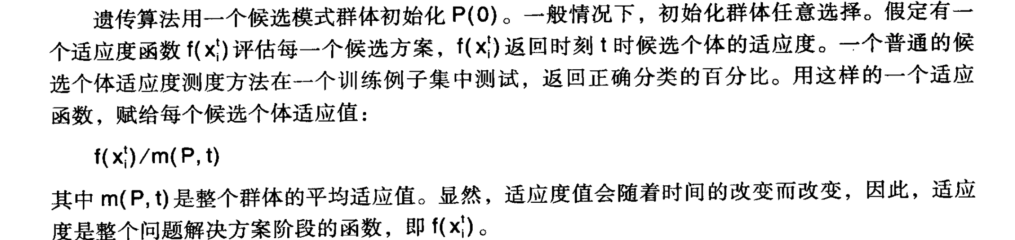
The genetic algorithm initializes P(0) to a population of candidate patterns. Typically, initial populations are selected randomly. Evaluation of candidate solutions assumes a fitness function, that returns a measure of the candidate’s fitness at time t. A common measure of a candidate’s fitness tests it on a set of training instances and returns the percentage of correct classifications. Using such a fitness function, an evaluation assigns each candidate solution the value:
where m(P,t) is the average fitness over all members of the population.

Slide 17
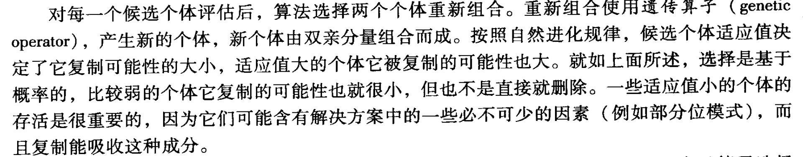
After evaluating each candidate, the algorithm selects pairs for recombination. Recombination uses genetic operators to produce new solutions that combine components of their parents.
As with natural evolution, the fitness of a candidate determines the extent to which it reproduces, with those candidates having the highest evaluations being given a greater probability of reproducing.

Slide 18
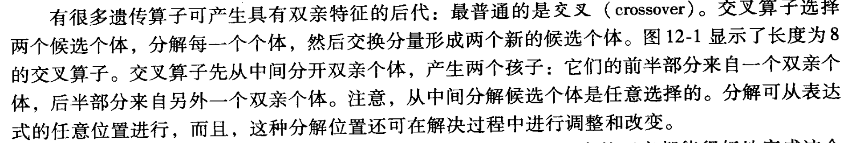
There are a number of genetic operators that produce offspring having features of their parents; the most common of these is crossover. Crossover takes two candidate solutions and divides them, swapping components to produce two new candidates. Figure 12.1 illustrates crossover on bit string patterns of length 8.

Slide 19
Input Bit String:
: :
1 1 # 0 : 1 0 1 # # 1 1 0 : # 0 # 1
: :
Resulting New Strings:
1 1 # 0 # 0 # 1 # 1 1 0 1 0 1 #
Figure 12.1 Use of crossover on two bit strings of length eight. # is don’t care.

Slide 20
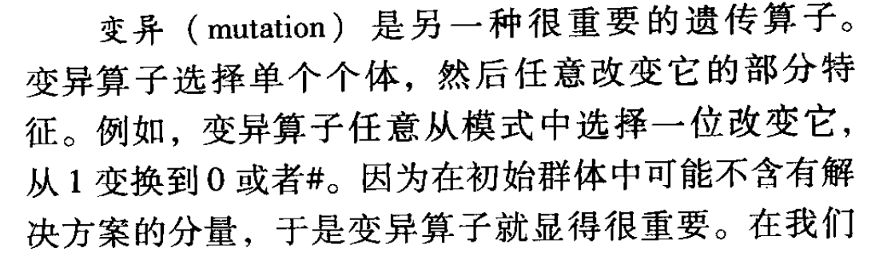
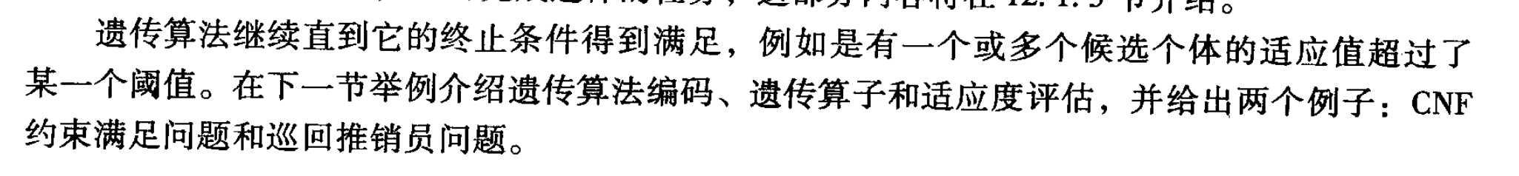
Mutation is another important genetic operator. Mutation takes a single candidate and randomly changes some aspect of it.
The genetic algorithm continues until some termination requirement is met, such as having one or more candidate solutions whose fitness exceeds some threshold.

Slide 21
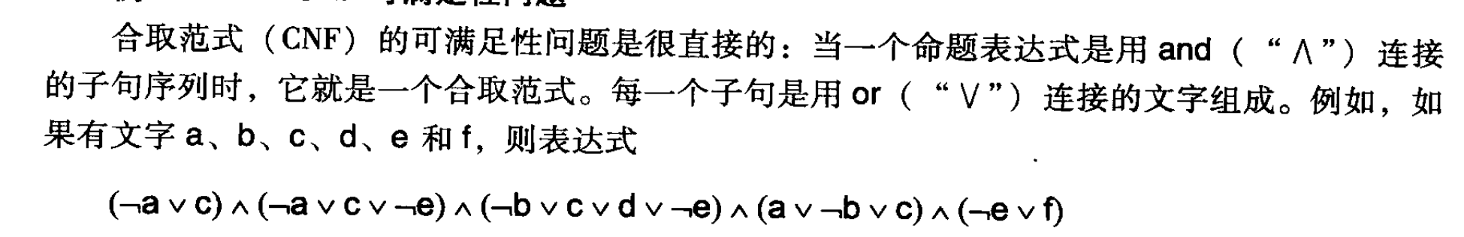
12.1.3 Two Examples: CNF Satisfaction and the Traveling Salesperson
EXAMPLE 12.2.1: THE CNF-SATISFACTION PROBLEM
The conjunctive normal form (CNF) satisfiability problem is straightforward: an expression of propositions is in conjunctive normal form when it is a sequence of clauses joined by an and(∧) relation. Each of these clauses is in the form of a disjunction, the or (∨), of literals. For example, if the literals are, a, b, c, d, e, and f, then the expression:
(﹁a ∨ c) ∧(﹁a ∨ c ∨ ﹁e) ∧(﹁b ∨ c ∨ d ∨ ﹁e) ∧(a ∨ ﹁b ∨ c) ∧(﹁e ∨ f)
is in CNF.

Slide 22
CNF satisfiability means that we must find an assignment of true or false (1 or 0) to each of the six literals, so that the CNF expression evaluates to true.
A natural representation for the CNF satisfaction problem is a sequence of six bits, each bit, in order, representing true(1) or false(0) for each of the six literals, again in the order of a, b, c, d, e, and f. Thus:
1 0 1 0 1 0
indicates that a, c, and e are true and b, d, and f are false, and the example CNF expression is therefore false.

Slide 23
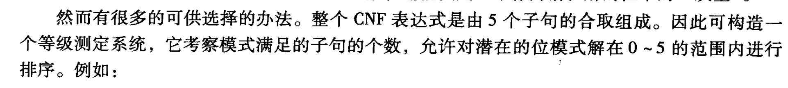
The choice of a fitness function for this population of bit strings have a number of alternatives. One would be to note that the full CNF expression is made up of the conjunction of five clauses. Thus we can make up a rating system that will allow us to rank potential bit pattern solutions in a range of 0 to 5, depending on the number of clauses that pattern satisfies. Thus the pattern:

Slide 24
1 1 0 0 1 0 has fitness 1,
0 1 0 0 1 0 has fitness 2,
0 1 0 0 1 1 has fitness 3, and
1 0 1 0 1 1 has fitness 5, and is a solution.
This genetic algorithm offers a reasonable approach to the CNF satisfaction problem.

Slide 25
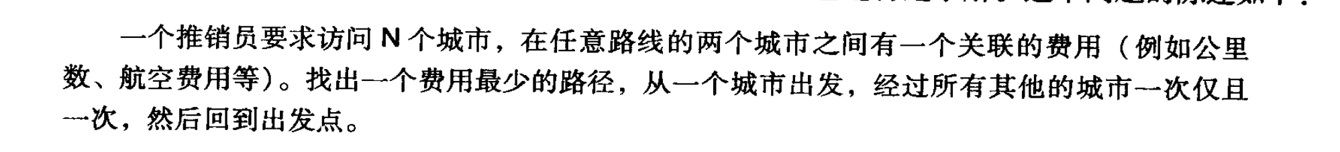
EXAMPLE 12.2.2: THE TRAVELING SALESPERSON PROBLEM
The statement of the problem is simple:
A salesperson is required to visit N cities as part of a sales route. There is a cost (e.g., mileage, air fare) associated with each pair of cities on the route. Find the least cost path for the salesperson to start at one city, visit all the other cities exactly once and return home.

Slide 26
Let’s consider some obvious representations that turn out to have complex ramifications. Suppose we have nine cities to visit, 1, 2,…, 9, so we make the representation of a path the ordered listing of these nine integers. Suppose we simply make each city a four-bit pattern, 0001, 0010,… 1001. Thus, the pattern:
0001 0010 0011 0100 0101 0110 0111 1000 1001
represents a visit to each city in the order of its numbering.

Slide 27
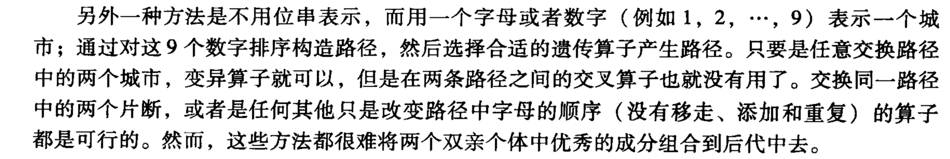
Another approach to the TSP would be to ignore the bit pattern representation and give each city an alphabetic or numeric name, e.g., 1,2,…,9; make the path through the cities an ordering of these nine digits ,and then select appropriate genetic operators for producing new paths.
Make it difficult to combine into offspring the “better” elements of patterns within the paths of cities of the two different parents.

Slide 28
A number of researchers (Davis 1985, Oliver et al. 1987) have created crossover operators that overcome these problems and let us work with the ordered list of cities visited. For example, Davis has defined an operator called order crossover. Suppose we have nine cities,1,2,…,9, and the order of the integers represents the order of visited cities.
Order crossover builds offspring by choosing a subsequence of cities within the path of one parent. First, select two cut point, indicated by a “|”. For example, for two parents p1 and p2, with cut points after the third and seventh cities:

Slide 29
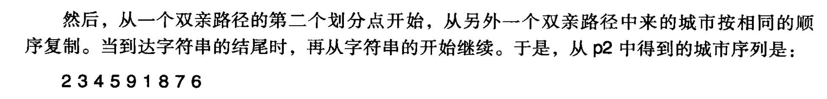
p1=(1 9 2 | 4 6 5 7 | 8 3)
p2=(4 5 9 | 1 8 7 6 | 2 3)
First, the segments between cut points are copied into the offspring:
c1=(x x x | 4 6 5 7 | x x)
c2=(x x x | 1 8 7 6 | x x)
Next, starting from the second cut point of one parent, the cities from the other parent are copied in the same order, omitting cities already present. When the end of the string is reached, continue on from the beginning. Thus, the sequence of cities from p2 is:

Slide 30
2 3 4 5 9 1 8 7 6
Once cities 4,6,5, and 7 are removed, since they are already part of the first child, we get the shortened list 2,3,9,1,and 8, which then makes up, preserving the ordering found in p2, the remaining cities to be visited by c1:
c1=(2 3 9 | 4 6 5 7 | 1 8)
In a similar manner we can create the second child c2:
c2=(3 9 2 | 1 8 7 6 | 4 5)

Slide 31
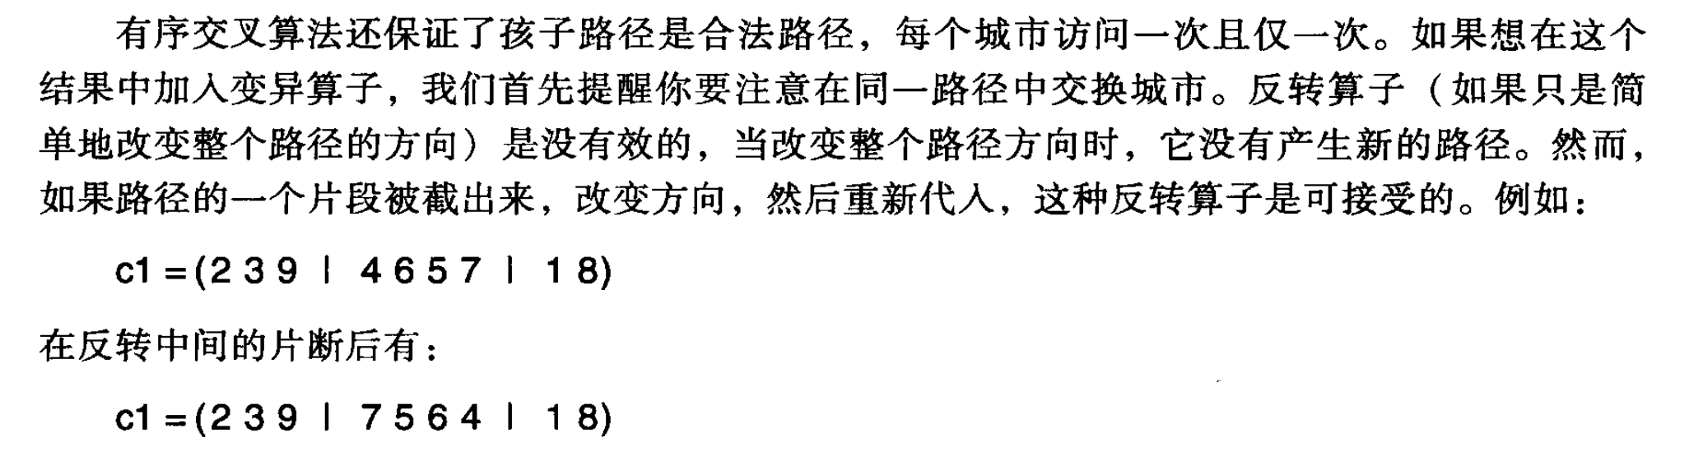
If a piece within the path is cut out and inverted and then replaced, it would be an acceptable use of inversion. For example, using the cut | indicator as before, the path:
c1=(2 3 9 | 4 6 5 7 | 1 8),
becomes under inversion of the middle section,
c1=(2 3 9 | 7 5 6 4 | 1 8)

Slide 32
12.1.4 Evaluating the Genetic Algorithm
The representation selected must support the genetic operators.
Finally, genetic operators must pass on “meaningful” pieces of potential solution information to the next generation.
We leave representation with one final issue, the problem of the “naturalness” of a selected representation. Suppose, as a simple, if somewhat artificial, example, we want our genetic operators to differentiate between the numbers 6,7,8, and 9.
表示方法的选择必须支持遗传算子
遗传算子必须传递给后代信息丰富的潜在解的片段
选择表示的自然性问题。

Slide 33
An integer representation gives a very natural and evenly spaced ordering, because, within base ten integers, the next item is simply one more than the previous. With change to binary, however, this naturalness disappears. Consider the bit patterns for 6,7,8, and 9:
0110 0111 1000 1001
For instance, a gray coded version of the first sixteen binary numbers may be found in Table 12.1.

Slide 34
6.2.3 编码
位串编码
（2） Gray 编码
Gray编码:将二进制编码通过一个变换进行转换得到的编码。
二进制串
Gray
二进制编码 → Gray编码
Gray编码 → 二进制编码

Slide 35
Binary Gray | Binary Gray
0000 0000 0001 0001 0010 0011 0011 0010 0100 0110 0101 0111 0110 0101 0111 0100 | 1000 1100 1001 1101 1010 1111 1011 1110 1100 1010 1101 1011 1110 1001 1111 1000
Table 12.1 The gray coded bit patterns for the binary numbers 0,1,…,15.

Slide 36
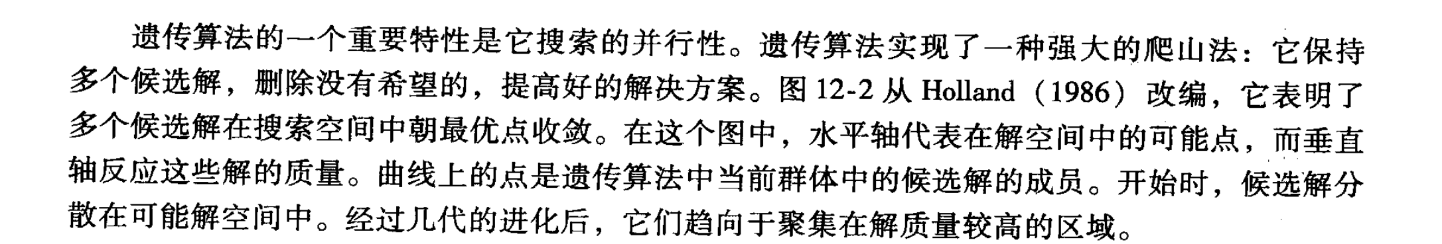
An important strength of the genetic algorithm is in the parallel nature of its search. Genetic algorithms implement a powerful form of hill climbing that maintains multiple solutions, eliminates the unpromising, and improves good solutions. Figure 12.2, adapted from Holland (1986), shows multiple solutions converging toward optimal points in a search space.

Slide 37
水平轴代表解空间中的可能点，垂直轴反应这些解的质量。可以看到，开始时，候选解分布在可能的解空间。经过几代的进化后，他们趋向聚集在质量较高的区域。
Solution Quality Solution Quality
Search Space Search Space
a. The beginning search space b. The search space after n
generations
Figure 12.2 Genetic algorithms visualized as parallel hill
climbing, adapted from Holland (1986).

Slide 38
Note also that genetic algorithms, unlike sequential forms of hill climbing, as in Section 4.1, do not immediately discard unpromising solutions. Through genetic operations, even weak solutions may continue to contribute to the makeup of future candidate solutions.
Another difference between genetic algorithms and the state space heuristics presented in Chapter 4 is the analysis of the present-state/goal-state difference.

Slide 39
An important source of the genetic algorithm’s power is the implicit parallelism inherent in evolutionary operators. In comparison with state space search and an ordered open list, search moves in parallel, operating on entire families of potential solutions. By restricting the reproduction of weaker candidates, genetic algorithms may not only eliminate that solution, but all of its descendants.
As genetic algorithms are more widely used in applied problem solving as well as in scientific modeling, there is increasing in attempts to understand their theoretical foundations. Several questions that naturally arise are:

Slide 40
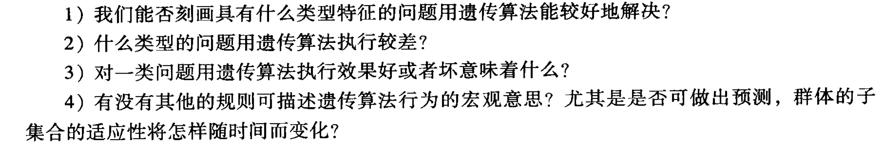
1. Can we characterize types of problems for which GAs will perform well?
2. For what problem types do they perform poorly?
3. What does it even “mean” for a GAto perform well or poorly for a problem type?
4. Are there any laws that can describe the macrolevel of behavior of Gas? In particular, are there any predictions that can be made about the changes in fitness of subgroups of the population over time?

Slide 41
5. Is there any way to describe the differential effects of different genetic operators, crossover, mutation, inversion, etc., over time?
6. Under what circumstances (what problems and what genetic operators) will Gas perform better than traditional AI search methods?

Slide 42
12.2 Classifier Systems and Genetic Programming
This section discusses examples of each approach to extending the power of genetic algorithms.

Slide 43
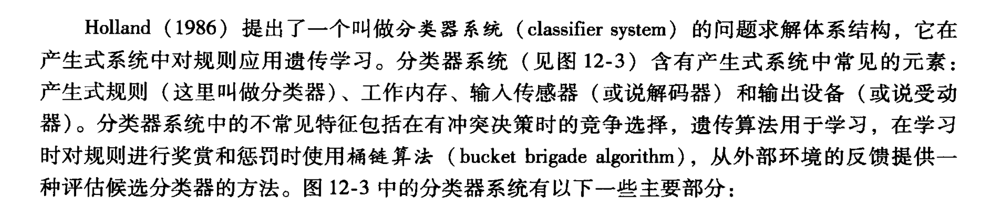
12.2.2 Classifier Systems
Holland (1986) developed a problem- solving architecture called classifier systems that applies genetic learning to rules in a production system. A classifier system (Figure 12.3) includes the familiar elements of a production system: production rules (here called classifiers), working memory, input sensors (or decoders), and outputs (or effectors). The classifier system so Figure 12.3 has the following major components:

Slide 44
1. Detectors of input messages from the environment.
2. Detectors of feedback messages from the environment.
3. Effectors translating results of rule applications back to the environment.
4. A production rule set made up of a population of classifiers. Each classifier has an associated fitness measure.
5. A working memory for the classifier rules. This memory integrates the results of production rule firing with input information.

Slide 45
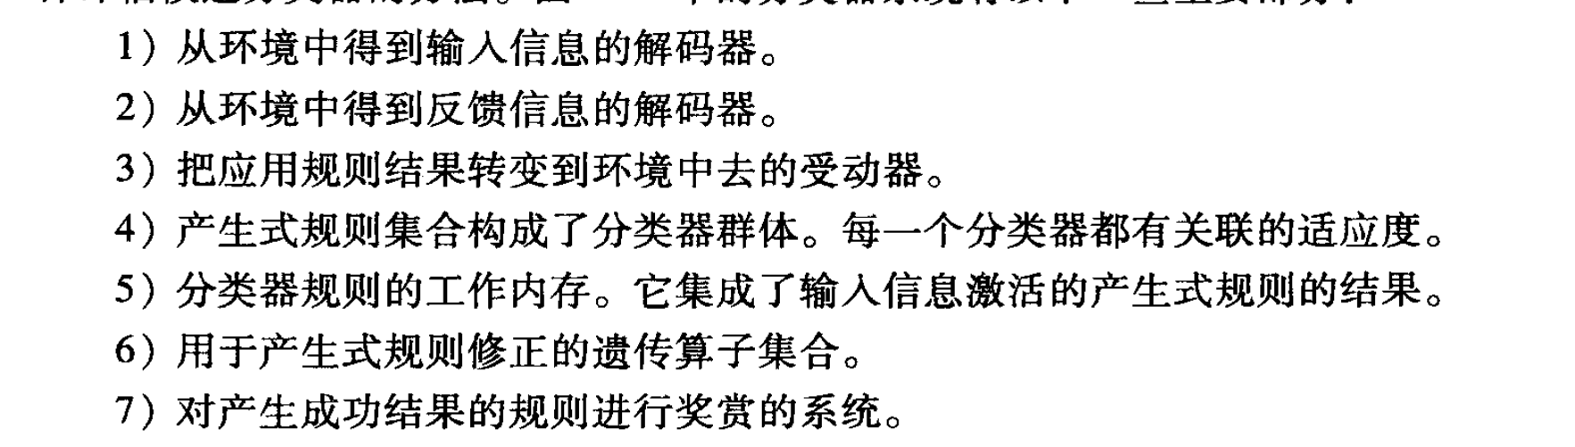
6. A set of genetic operators for production rule modification.
7. A system for giving credit to rules involved in producing successful actions.

Slide 46
Figure 12.3 A classifier system interacting with the environment, adapted from Holland (1986).
input
decoder
Input message list
working memory internal messages
environment
output
effector
output message list
genetic operators for rule changes
production memory classifier rules
feedback
Bucket brigade credit assignment
decoder

Slide 47
Classifier systems implement a form of reinforcement learning, Section 10.7.
Classifier systems learn in two ways. First, there is a reward system that adjusts the fitness measures of the classifier rules, rewarding successful rule firings and penalizing errors.
The second form of learning modifies the rules themselves using genetic operators such as mutation and crossover.

Slide 48
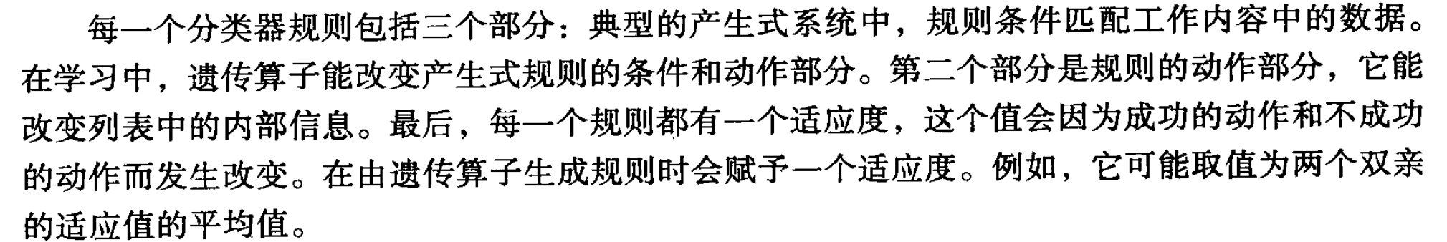
Each classifier rule consists of three components: the rule’s condition matches data in the working memory in the typical production system sense. In learning, genetic operators can modify both the conditions and the actions of the production rules. The second component of the rule, the action, can have the effect of changing the internal message list (the production memory). Finally, each rule has a fitness measure.

Slide 49
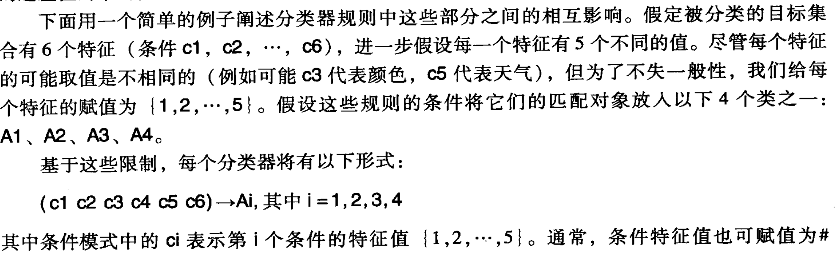
A simple example illustrates the interactions of these components of a classifier system.
Six attributes (conditions c1, c2, …, c6), each attribute can have five different values. Give each attribute an integer value from {1,2,…,5}.
Suppose the conditions of these rules place their matching object in one of four classes: A1, A2, A3, A4.
Based on these constraints, each classifier will have the form:

Slide 50
(c1 c2 c3 c4 c5 c6)->Ai, where i = 1,2,3,4.
Where each ci in the condition pattern denotes the value {1,2,…,5} of the ith attribute of the condition.
Table 12.2 presents a set of classifiers.
Condition (Attributes) Action (Classification) Rule Number
(1 # # # 1 #) → A1 1 (2 # # 3 # #) → A1 2 (# # 4 3 # #) → A2 3 (1 # # # # #) → A2 4 (# # 4 3 # #) → A3 5 etc.

Slide 51
In order to simplify the remainder of the example, we will only consider the classifier system’s performance in learning the classification A1. For example, the classifiers of Table 12.2 may be summarized by:
(1 # # # 1 #) → (1 0 0 0)
(2 # # 3 # #) → (1 0 0 0)
(1 # # # # #) → (0 1 0 0)
(# # 4 3 # #) → (0 1 1 0)

Slide 52
Each condition pattern is also assigned a strength, or fitness, parameter (a real number between 0.0, no strength, and 1.0, full strength). This strength parameter, s, is computed from the fitness of each rule’s parents, and measures its historical fitness.
At each learning cycle, the rules attempt to classify the inputs and are then ranked by the teacher or fitness metric. For example, assume that at some cycle, the classifier has the following population of candidate classification rules, where the conclusion of 1 indicates that the pattern led to a correct classifcation and 0 that it did not:

Slide 53
(# # # 2 1 #) → 1 s=0.6
(# # 3 # # 5) → 0 s=0.5
(2 1 # # # #) → 1 s=0.4
(# 4 # # # 2) → 0 s=0.23

Slide 54
Suppose a new input message arrives from the environment: (1 4 3 2 1 5), and the teacher (using the first rule of Table 12.2) classifies this input vector as a positive example of A1. Rules 1 and 2 match. Conflict resolution is done through competitive bidding among matching rules. In our example, bidding is a function of the sum of the matches of the attribute values times the strength measure of the rule. “Don’t care” matches have the value 0.5, while exact matches have value 1.0. To normalize we divide this result by the length of the input vector.

Slide 55
Since the input vector matches the first classifier with two exact and four “don’t cares,” its bid is ((4*0.5+2*1)*0.6)/6, or 0.4. The second classifier also matches two attributes and has four “don’t cares,” so its bid is 0.33.
The first rule wins and posts its action, a 1, indicating that this pattern is an example of A1.

Slide 56
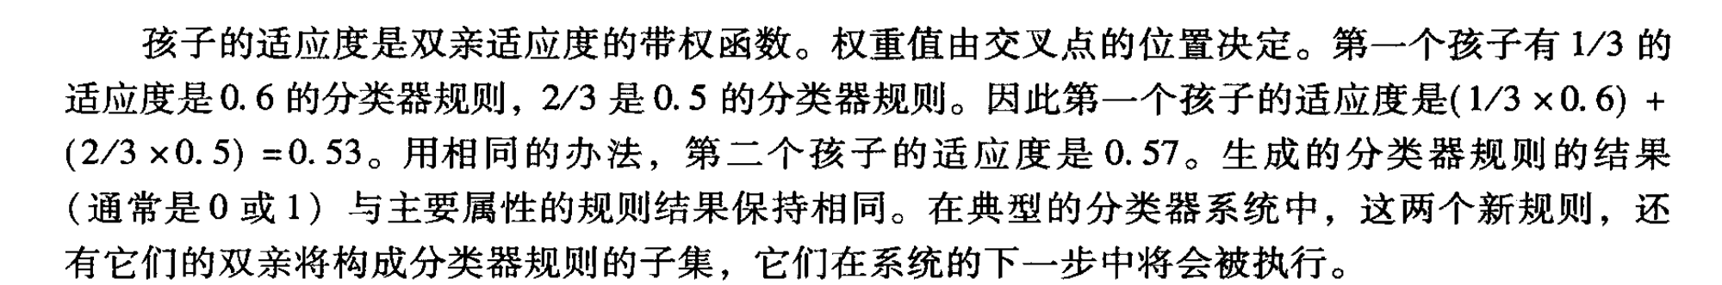
Once the fitness of the candidate rules has been computed, the learning algorithm applies genetic operators to create the next generation of rules. Randomly selecting a crossover position between the fourth and fifth elements,
(# # # 2 | 1 #) → 1 s=0.6
(# # 3 # | # 5) → 0 s=0.5
produces the offspring:
(# # 3 # | 1 #) → 0 s=0.53
(# # # 2 | # 5) → 1 s=0.57

Slide 57
The fitness measure of the children is a weighted function of the fitness of the parents. The weighting is a function of where the crossover point lies.
A mutation operator may also be defined. A simple mutation rule would be to randomly change any attribute pattern to some other valid attribute pattern. Mutation operators are seen as forcing diversity into the search for classifiers, while crossover attempts to preserve and build new children from successful pieces of parental patterns.

Slide 58
12.2.2 Programming with Genetic Operators
Genetic programming starts with an initial population of randomly generated programs made up of appropriate program pieces. These pieces, suitable for a problem domain, may consist of standard arithmetic operations, other related programming operations, and mathematical functions, as well as logical and domain-specific functions. Program components include data items of the usual types: boolean, integer, floating point, vector, symbolic, or multiple-valued.

Slide 59
After initialization, thousands of computer programs are genetically bred. The production of new programs comes with application of genetic operators. Crossover, mutation, and other breeding algorithms must be customized for the production of computer programs.
To summarize, genetic programming includes six components, many very similar to the requirements for GAs:

Slide 60
1. A set of structures that undergo transformation by genetic operators.
2. A set of initial structures suited to a problem domain.
3. A fitness measure, again domain dependent, to evaluate structures.
4. A set of genetic operators to transform structures.
5. Parameters and state descriptions that describe members of each generation.
6. A set of termination conditions.

Slide 61
Genetic programming manipulates hierarchically organized program modules.
Genetic operators manipulate s-expressions.
Genetic programming will construct useful programs, given that the atomic pieces and evaluable predicates of the problem domain are available.
To initialize the structures for adaptation by genetic operators, we must create two sets: F, the set of functions and T, the set of terminal values required for the domain.

Slide 62
Next, a population of initial “programs” is generated by randomly selecting elements from the union of sets F and T.
The program we have randomly produced is represented in Figure 12.4. Figure 12.4a gives the tree after the first selection of +, 15.4b after selecting the terminal 6, and 15.4c the final program

Slide 63
+
+
*
+
*
6
6
+
8
a.
b.
7
5
c.
Figure 12.4 The random generation of a program to initialize.
The circled nodes are from the set of functions.

Slide 64
The fitness measure is problem domain dependent and usually consists of a set of tasks the evolved programs must address. The fitness measure itself is a function of how well each program does on these tasks.
Genetic operators on programs include both transformations on a tree itself as well as the exchange of structures between trees. Koza (1992) describes the primary transformations as reproduction and crossover. Reproduction simply selects programs from the present generation and copies them (unchanged) into the next generation. Crossover exchanges subtrees between the trees representing two programs.

Slide 65
For example, suppose we are working with the two parent programs of Figure 12.5, and that the random points indicated by | in parent a and parent b are selected for crossover. The resulting children are shown in Figure 12.6.

Slide 66
+
-
*
+
8
*
4
6
10
SIN
COS
8
a.
6
3
b.
Figure 12.5 Two programs, selected on fitness for crossover. Point | from a and b are randomly selected for crossover

Slide 67
+
-
COS
+
8
*
3
10
SIN
*
8
6
4
6
a.
b.
Figure 12.6 The child programs produced by crossover of the points in
Figure 12.5.

Slide 68
EXAMPLE 3.2.1: EVOLVING A PROGRAM FOR KEPLER’S THIRD LAW OF PLANETARY MOTION
Kepler’s Third Law of Planetary Motion describes the functional relationship between the orbital period, P, of a planet and its average distance, A, from the sun.
The function for Kepler’s Third Law, with c a constant is:

Slide 69
If we assume that P is expressed in units of earth years, and A is expressed in units of earth’s average distance from the sun, then c=1. The s-expression of this relationship is:
P=(sqrt(*A(*AA)))
And so the program we want to evolve is represented by the tree structure of Figure 12.7.

Slide 70
SQRT
*
A
*
A
A
Figure 12.7 The target program relating orbit to period for
Kepler s Third Law.

Slide 71
The initial population might include:
(*A(-(*AA) (sqrt A))) fitness: 1
(/A(/(/AA) (/AA))) fitness: 3
(+A(*(sqrt A) A)) fitness: 0
These three examples are described by the program trees of Figure 12.8.

Slide 72
*
/
+
A
-
A
/
A
*
*
/
SQRT
/
SQRT
A
A
A
A
A
A
A
A
A
fitness=1
fitness=3
fitness=0
Figure 12.8 Members from the initial population of programs to solve the
orbital period problem.

Slide 73
Next we determine a suite of tests for the population of programs. We have the planetary data in Table 12.3, taken from Urey (1952), which gives a set of data points that the evolving programs must explain.

Slide 74
Planet A (input) P (output)
Venus 0.72 0.61 Earth 1.0 1.0 Mars 1.52 1.87 Jupiter 5.2 11.9 Saturn 9.53 29.4 Uranus 19.1 83.5
Table 12.3 A set of fitness cases, with planetary data taken from Urey
(1952). A is Earth s semi-major axis of orbit and P is in units of
earth-years.

Slide 75
Since the fitness measure is a function of the data points we want to explain, we define fitness as the number of outputs of the program that come within 20 per cent of the correct output values. We use this definition to create the fitness measures of the three programs of Figure 12.8.

Slide 76
12.3 Artificial Life and Society-Based Learning
The Game of Life is a simple example of a model of computation called cellular automata (CA).
D E F I N I T I O N
FINITE-STATE MACHINE or CELLULAR AUTOMATON
1. A set I called the input alphabet.
2. A set S of states that the automaton can be in.
3. A designated state s0, the initial state.
4. A next state function N: S x I → S, that assigns a next
state to each ordered pair consisting of a current state
and a current input.

Slide 77
The cellular automata makes the input to the present state a function of its “neighbor” states. Thus, the state at time (t+1) is a function of its present state and the state of its neighbors at time t.
Because the output of all states of a system is a function of their neighboring states, we can describe the evolution of a set of neighboring FSMs as society-based adaptation and learning

Slide 78
12.3.1 The “Game of Life”
Consider the simple two-dimensional grid or game board of Figure 12.9. Here we have one square “occupied” – having bit value 1 – in black, with its eight nearest neighbors indicated by gray shading. The board is transformed over time periods, where the state of each square at time t+1 is a function of its state and the state of these indicated nearest neighbors at time t. Three simple rules can drive evolution in the game: First, if any square, occupied or not, has exactly three of its nearest neighbors occupied, it will be occupied at the next time period. Second, if any occupied square has exactly two of its nearest neighbors occupied, it will be occupied in the next time period.

Slide 79
Finally, for all other situations the square will not be occupied at the next time period
Figure 12.9 The shaded region indicates the set of neighbors for the
game of life

Slide 80
Consider, for example, the state of life for Figure 12.10a.
At the next life cycle Figure 12.10b will be produced.
Poundstone (1985) describes the extraordinary variety and richness of the structures that can emerge in the game of life, such as gliders, patterns of cells that move across the world through repeated cycles of shape changes, as is seen in Figure 12.12.

Slide 81
X
Y
Y
X
a. b.
Figure 12.10 A set of neighbors generating the blinking light
phenomenon.

Slide 82
a. b.
Figure 12.11 What happens to these patterns the next
time cycle?

Slide 83
The sequence of time cycles demonstrated in Figure 12.12 implements the glider that was mentioned earlier. The glider sweeps across the game space by cycling among a small number of patterns. Its action is simple as it moves, in four time periods, to a new location one row further to the right and one row closer to the bottom of the grid.

Slide 84
time 0 time 1 time2 time 3 time 4
Figure 12.12 A glider moves across the display.

Slide 85
An interesting aspect of the game of life is that entities such as the glider persist until interacting with other members of their society; what then happens can be difficult to understand and predict. For example, in Figure 12.13, we see the situation where two gliders emerge and engage.

Slide 86
time 0 time 1 time 2 time 3 time 4
Figure 12.13 A glider is consumed by another entity.

Slide 87
12.3.2 Evolutionary Programming
We now discuss societies of linked FSMs and analyze them as emergent entities. This study is sometimes called evolutionary programming.
John von Neumann, in a series of lectures in 1949, explored the question of what level of organizational complexity was required for self-replication to occur (Burks 1970). Burks cites von Niumann’s goal as “…not trying to simulate the self-reproduction of a natural system at the level of genetics and biochemistry. He wished to abstract from the natural self-reproduction problem its logical form”.

Slide 88
Interestingly, von Niumann designed his self-replicating automaton, estimated to contain at least 40,000 cells, to have the functionality of a Universal Turing Machine.
Later Codd (1968) reduced the number of states required for a computationally universal, self-reproducing automaton from 29 to 8, but required an estimated 100,000,000 cells for the full design.
Later Devore simplified Codd’s machine to occupy only about 87,500 cells.

Slide 89
In modern times, Langton created a self-replicating automaton, without computational universality, where each cell had only eight states and occupied just 100 cells (Langton 1986, Hightower 1992, Codd 1992).
Rodney Brooks (1991a, b) at MIT has built a research program based on the premise of a-life, namely that intelligence emerges through the interactions of a number of simple autonomous agents.

Slide 90
Nils Nilsson and his students (Nilsson 1994, Benson 1995, Benson and Nilsson 1995) designed a teleo-reactive (T-R) program for agent control, a program that directs an agent towards a goal in a manner that continuously takes into account changing environmental circumstances.
The European commission is supporting the PACE, Programmable Artificial Cell Evolution, project.
The John Koza research effort in genetic programming at Stanford University continues to publish its many successes.

Slide 91
12.3.3 A Case Study in Emergence
The term emergent computation describes the appearance of global information processing structures in these systems.
Specifically, a cellular automaton (CA) is made up of a number of individual cells.
Each cell changes state as a function of its own state and the states of its two immediate neighbors.

Slide 92
Next we describe the rule set that determines the activity of the cells that make up each CA. Figure 12.15 presents a one-dimensional binary-state nearest neighbor CA, with N=11 cells. Both the lattice and the rule table for updating the lattice are presented.
The rule table supports the local majority vote rule: if a local neighborhood of three cells has a majority of ones, then the center cell becomes a one at the next time step; otherwise, it becomes a zero at the next time step.

Slide 93
Rule table:
neighborhood: 000 001 010 011 100 101 110 111
output bit: 0 0 0 1 0 1 1 1
Lattice
Neighborhood
t=0
1 | 0 | 1 | 0 | 0 | 1 | 1 | 1 | 0 | 1 | 0
t=1
0 | 1 | 0 | 0 | 0 | 1 | 1 | 1 | 1 | 0 | 1
Figure 12.15 Illustration of a one-dimensional, binary-state, nearest-neighbor
cellular automaton with N=11. Both the lattice and the rule table
for updating the lattice are illustrated. The lattice configuration is
shown over one time step. The cellular automaton is circular in
that the two end values are neighbors.

Slide 94
Crutchfield and Mitchell want to find a CA that performs the following collective computation, here called majority wins: if the initial lattice contains a majority of ones, the CA should evolve across time to all ones; otherwise, it should evolve to all zeros.

Slide 95
Sometimes, as in Figure 12.14a, these regions are obvious to the human viewer as invariant domains, that is, regions in which the same pattern recurs. We will label these domains as values, and then filter out the invariant elements in order to better describe the interactions (computations) effected by the intersections of these domains. Table 12.4 describes three regions: , the repeated 0s; , the repeated 1s; and , the repeated pattern 1001.

Slide 96
Regular Domains
Particles (Velocities)
Interactions
decay
react
annihilate
Table 12.4 Catalog of regular domains, particles (domain boundaries), particle velocities (in parentheses), and particle interactions of the space-time behavior of the CA of Figure 12.14a. The notation p~
means that p is the particle forming the boundary between regular domains and .

Slide 97
With the filtering out of invariant elements of the domains, we can see the interactions of these domains.
As an example, Figure 12.16 describes the emergent logic of Figure 12.14a.

